Slide 1
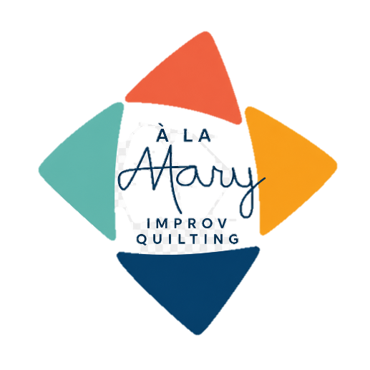
Play in Improv
Workbook
Mary Marcotte
marymarcotte.com
mary.marcotte@gmail.com
À LA MARY —
WHERE IMPROV MEETS INTENTION

Slide 2
Play in Improv Workbook
Class Overview
Improv defined: creating with an intuitive approach that may have the beginning of a plan but is open to interpretation, change, and play.
Seeing and hearing your quilt: stepping back, using your camera, playing on the design wall
Playing with your feelings: Answer questions about yourself; favorite colors and blocks; what kind of design and gridwork do you most like to work with, what do you know about background, scale, negative space, etc.
Improv play date: work with a friend taking turns making decisions concerning size, color, fabric or changes
Playing with your favorite block: ways to slice into the block, how to fit angles into your quilt, changing the scale of parts of your block, using patterns in different configurations, cutting patterns, adding skinnies between pattern parts
Wrap up: more quilts, recommended books

Slide 3
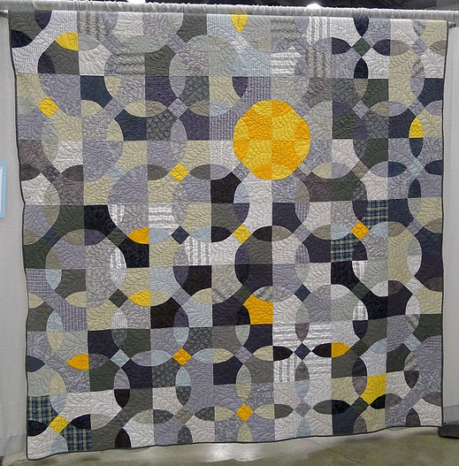
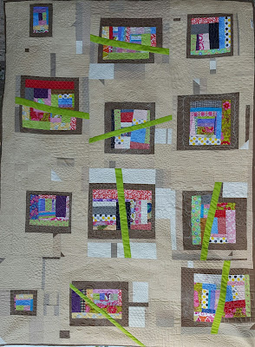
Reflections in Gray; 70″ x 84″; 2012 (Quiltcon 2013)
(maximalism, alternative gridwork)
Solicitude, 45″ X 60″, 2017
(Inspired by Cindy Grisdela’s
Adventures in Improv Quilts)
(use of negative space, alternative gridwork)

Slide 4
Play in Improv Workbook
You Will Learn
Improv Techniques—creating fabric from scraps, using traditional blocks, turning scraps into complex blocks, creating your own blocks
Organization of Improv Blocks and Chunks
Color Theory
Minimalism vs Maximalism in Modern Design
Alternative Gridwork in Modern Quilt Design
Negative Space in Modern Quilt Design

Slide 5
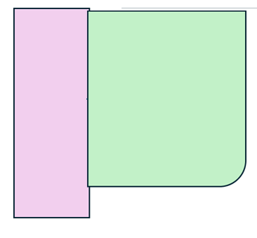
Begin with
two pieces
that are approximately the same size, and sew together
Continue sewing
scraps

Slide 6
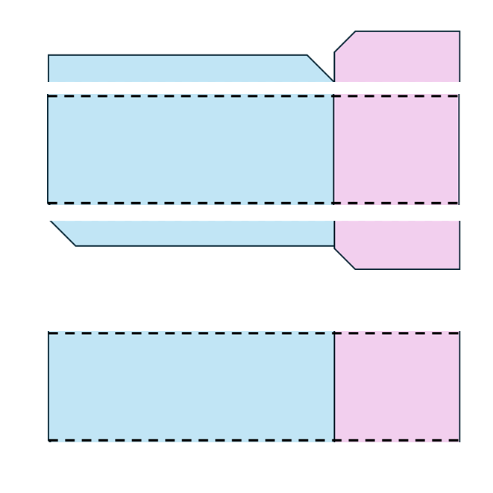
Trim edges, as needed

Slide 7


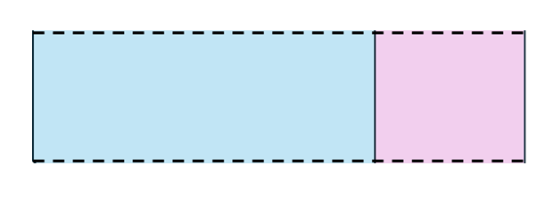

Slide 8
Sew together to create larger blocks

Slide 9
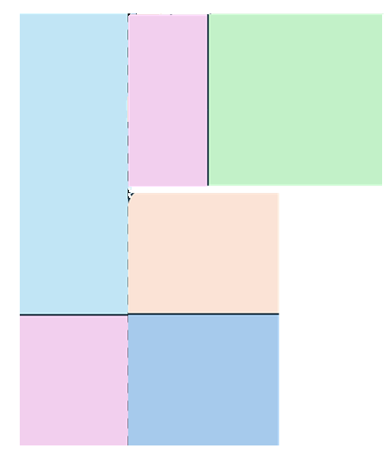
Trim as needed

Slide 10
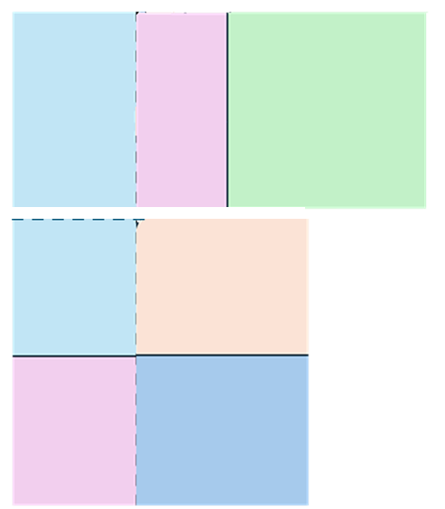
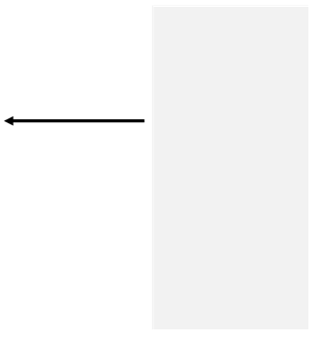
Continue adding scraps or create additional chunks that can be sewn together

Slide 11

Create large chunks by adding same size blocks together

Slide 12


Slide 13
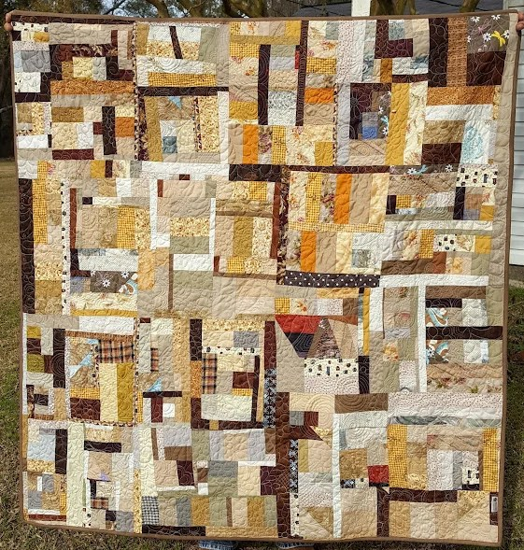
You can make entire quilts with scraps by simply creating and sewing chunks together. Now comes the fun: design wall play!
Murky Waters; 54″ X 56″; Jan 2017
(maximalism; alternative gridwork)

Slide 14
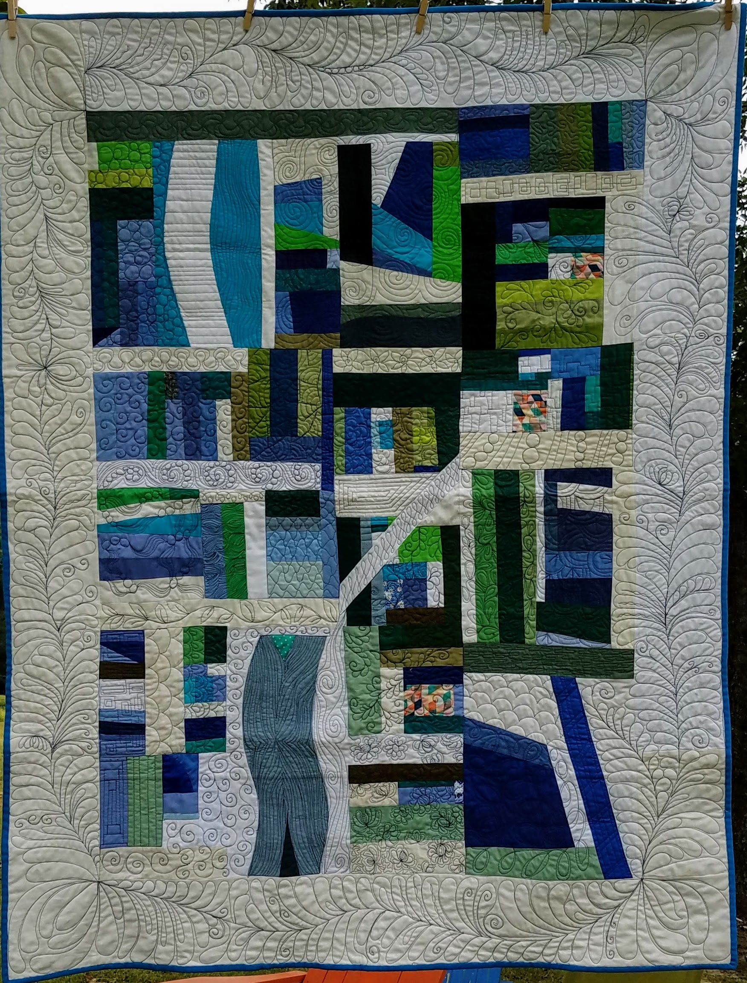
Five of your many options:
  Chinese coins (strips of solid fabric between strips of improv)
  Shape your fabric chunks into interesting forms and surround with negative space (works especially well for times when you don’t like the outcome)
  Use your chunks as the centerpiece of blocks for a medallion quilt
  Throw some neutral in the mix and separate chunks or parts of chunks
  Create different kinds of improv blocks—controlled improv—and mix them in
The Retreat 48" X 60“, 2020
(use of negative space; alternative gridwork)

Slide 15
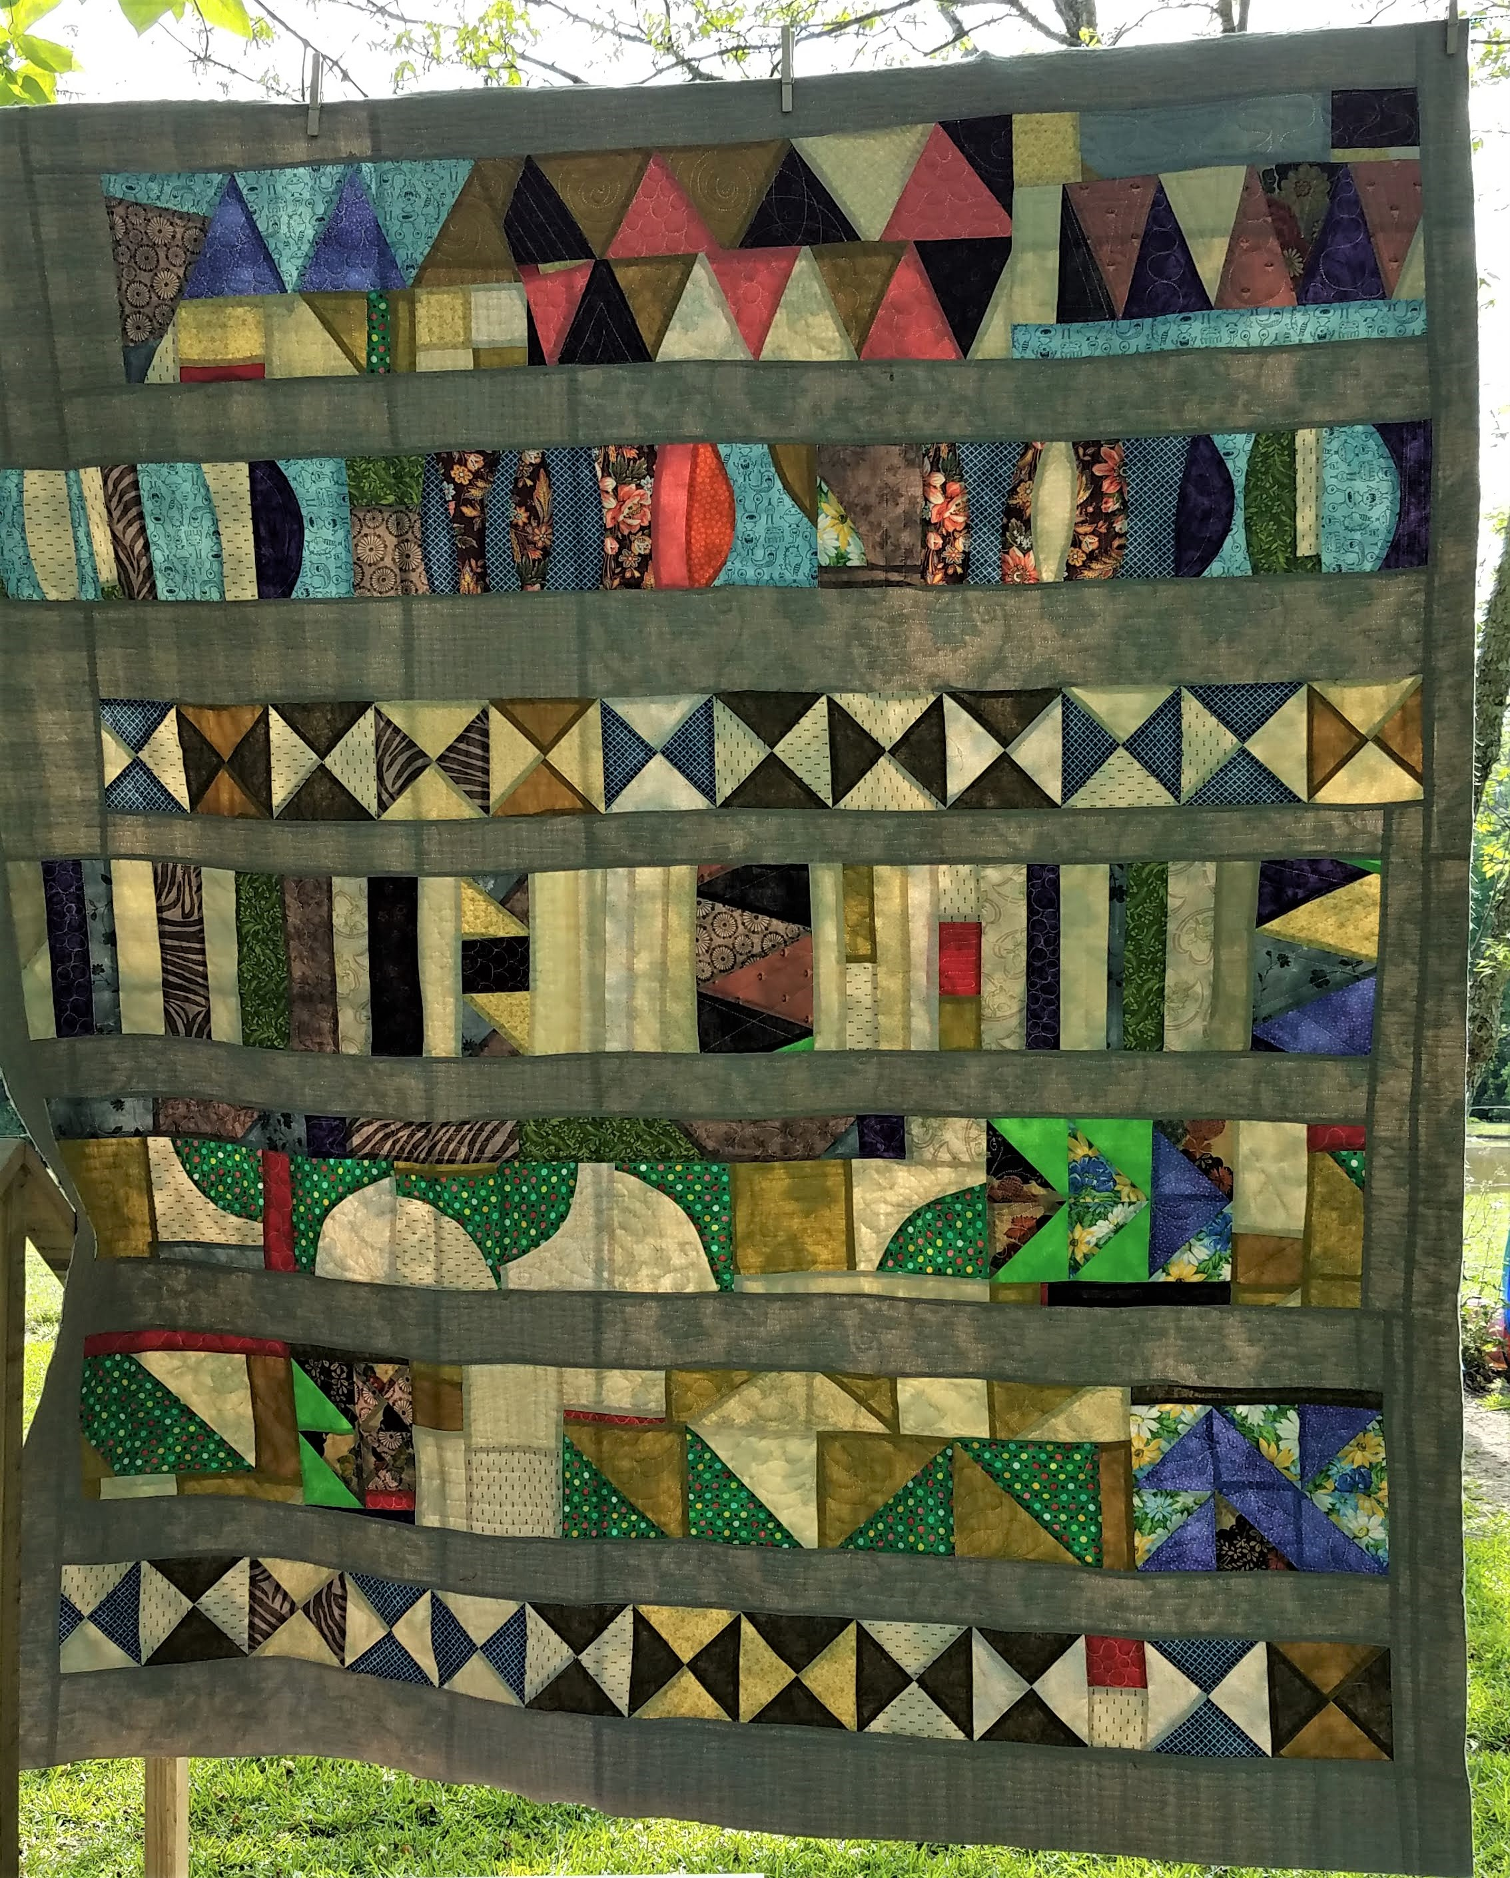
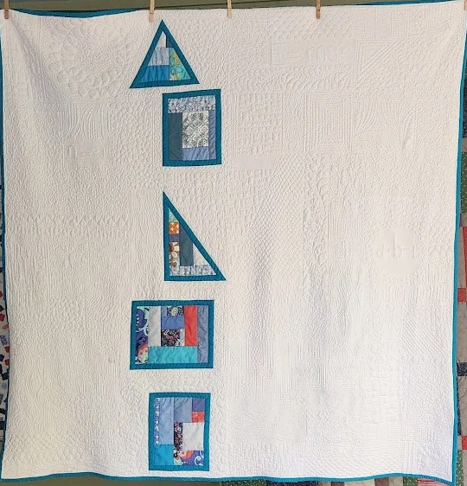
The Sherry Lynn Wood Quilt,
(Chinese coins; maximalism)
Math Is an Expletive; 59″ X 59″; 2015
(use of negative space; alternative gridwork)

Slide 16
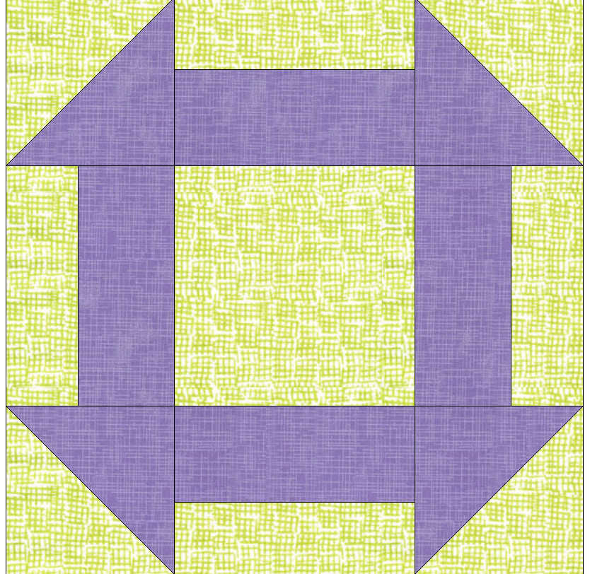
Modern Traditionalism
Conversely, you can make blocks from previously unwanted or orphan blocks, such as this Shoo-fly, or Hole in the Barn Door.

Slide 17
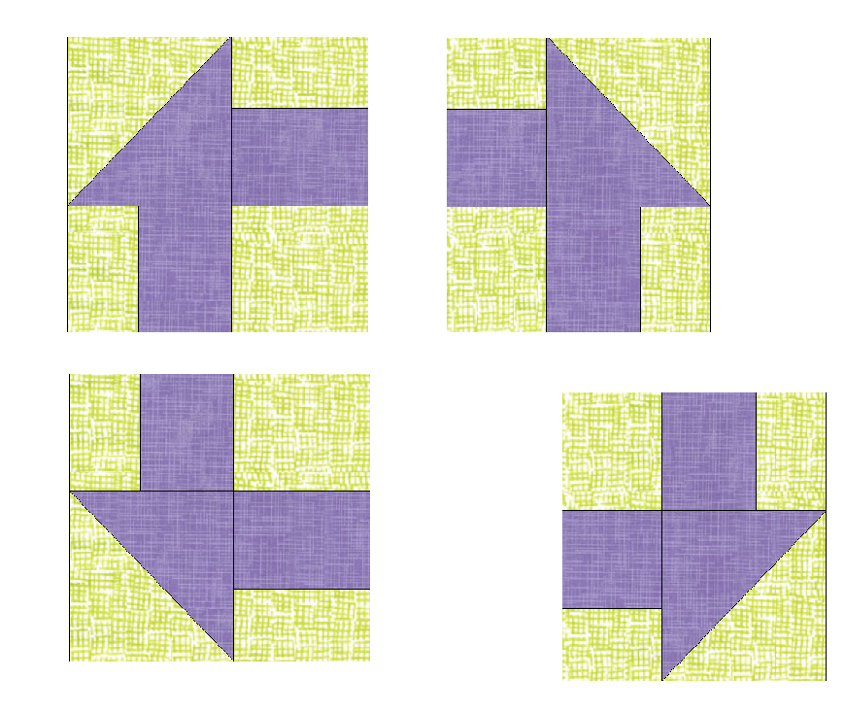
Begin by choosing how to cut the block into manageable pieces. An easy way to begin is to cut it into four semi-equal pieces.
Take one block at a time, cut it, and/or twist and turn the pieces to create a new block

Slide 18
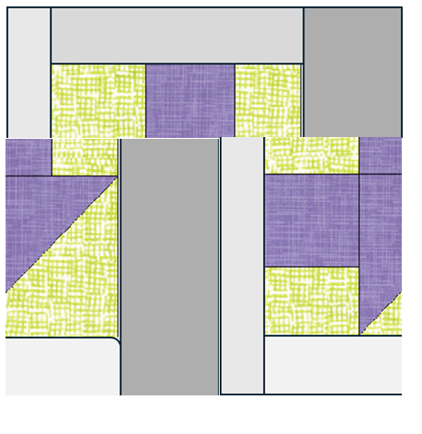
Here, I’ve taken a quarter piece wrapped in neutrals and cut it down again then rearranged them

Slide 19
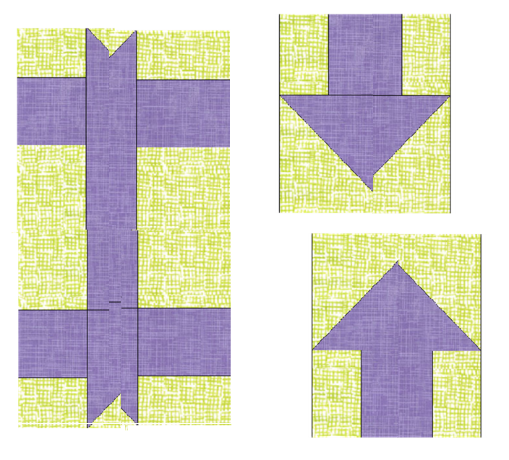
Another way to utilize a quarter of the shoofly is to cut it into fourths and rearrange the pieces. I discovered arrows using parts of the corners and a ribbon motif using the rest of the pieces. One of the delights of using this form of improv is the “discovery.”

Slide 20
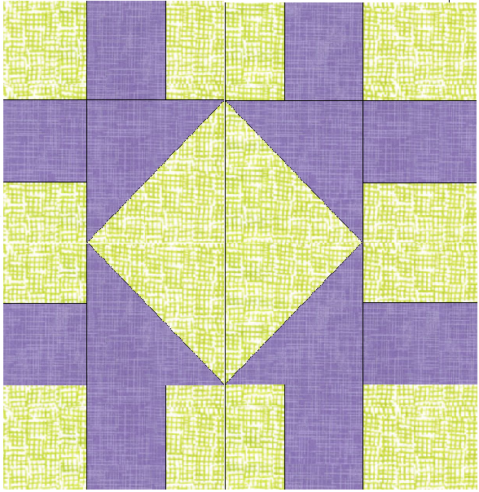
And finally, I simply switched each corner with the one opposite it and discovered this block. Imagine what might happen if I were to match the ribbon piece to this one…

Slide 21
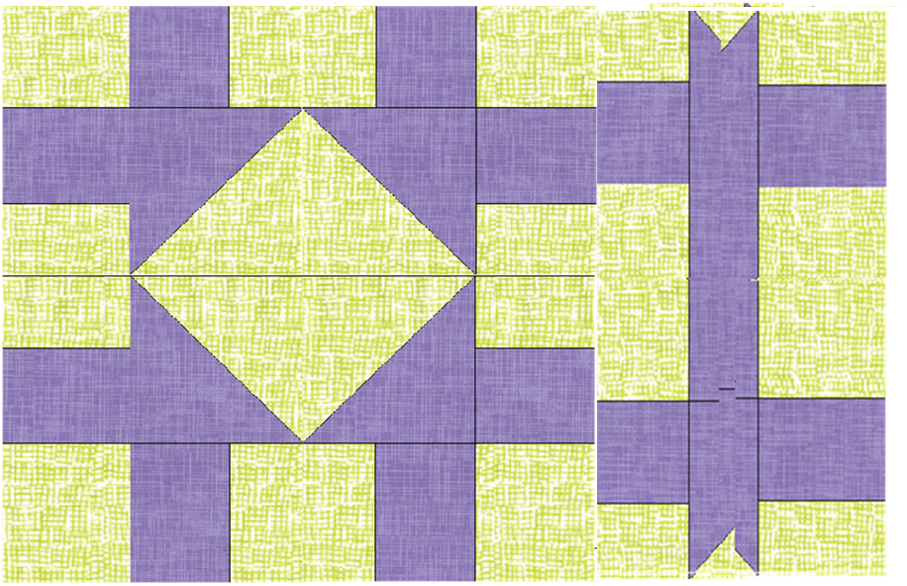

Slide 22
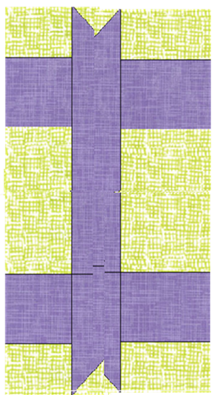
Now with a neutral strip between the two pieces
And speaking of neutrals…

Slide 23
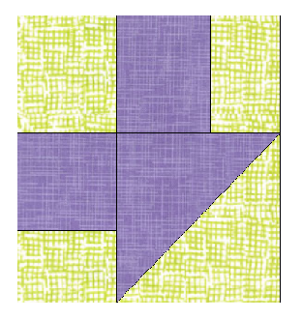
You can encircle the piece with neutral strips.

Slide 24
A piece like this one can be used in any way you wish. Note that I attached different colors and sizes to the edges. Now we have a piece of a block that forms the center of what could become a log-cabin block.

Slide 25
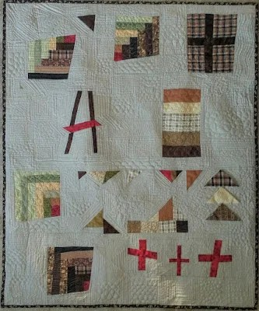
With enough neutral, and some scraps left over from the original project, I made this sampler quilt. The original orphan block was a courthouse steps block that I cut into four angled pieces. The plusses are from scraps. The corner pieces are some I was playing with in preparation to make a quilt using a technique from Sunday Morning Quilts by Amanda Jean Nyberg.
Modern Scrap Sampler; 37″ X 44″; 2016
(alternative gridwork; use of negative space)

Slide 26
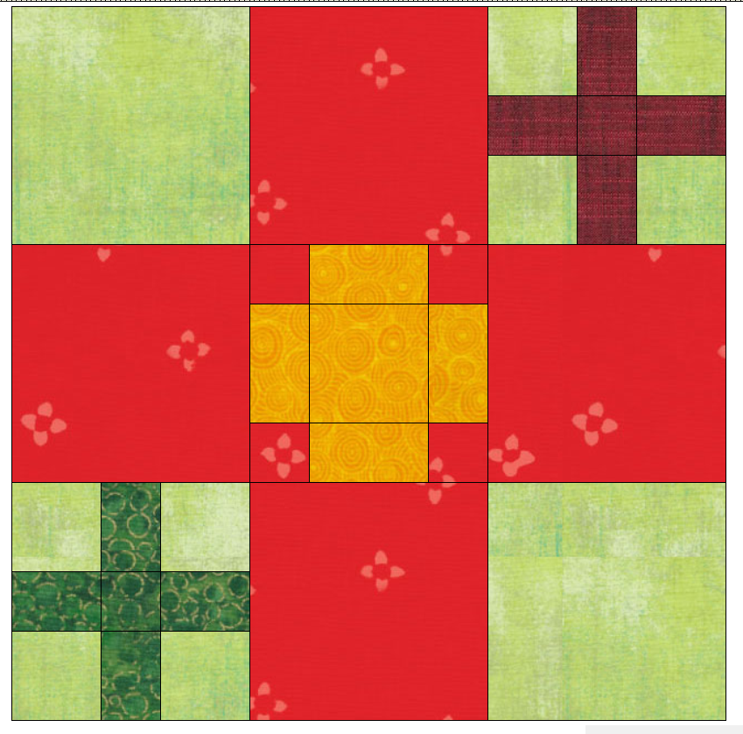
When you’re tired of a favorite…
We all have favorite blocks, but sometimes using the same block gets boring. You don’t have to quit on the block; instead, change it up to keep yourself interested.

Slide 27
Change the scale so that a small block will fit into a patch. These smaller blocks can be different sizes.

Slide 28
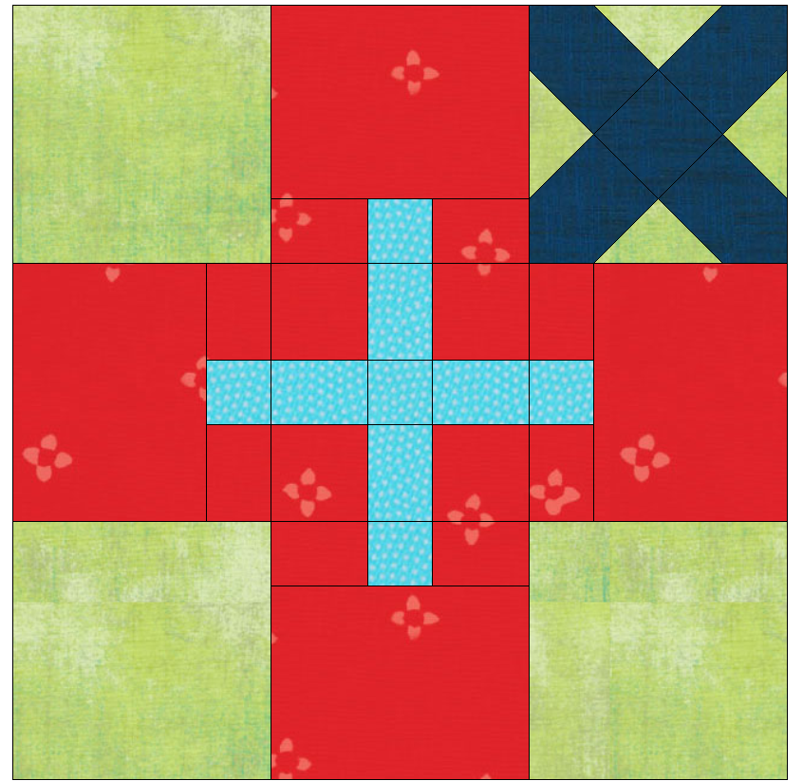
Put some blocks on point to create a secondary design, as in the upper left patch. Or play with the size of a design so it bleeds into surrounding patches as in the center patch.

Slide 29
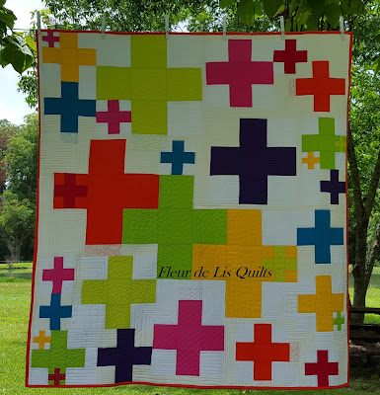
This happy cross quilt has five sizes of crosses. The largest ones are 12” blocks, the rest are in multiples of three. I did not stress over how or where they would fit. In fact, I decided to make the smallest blocks to fit into the patches of the largest and second largest as I was sewing it together. Hence, the reason that there are no tiny blocks in the center of the quilt.
Modern Crosses, large lap quilt, July 2015
(alternative grid work; use of negative space)

Slide 30
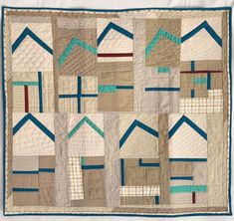
Neutrals make wonderful backgrounds because they blend well and “sink” away from the star color.
But they can play a supporting role, as well. In Row Houses, I ghost- quilted doors and windows in the background so the rally blocks become the roofs and the neutral seem to be part of the houses.
Row Houses; 30″ X 27″; 2020
(use of negative space, minimalism)

Slide 31
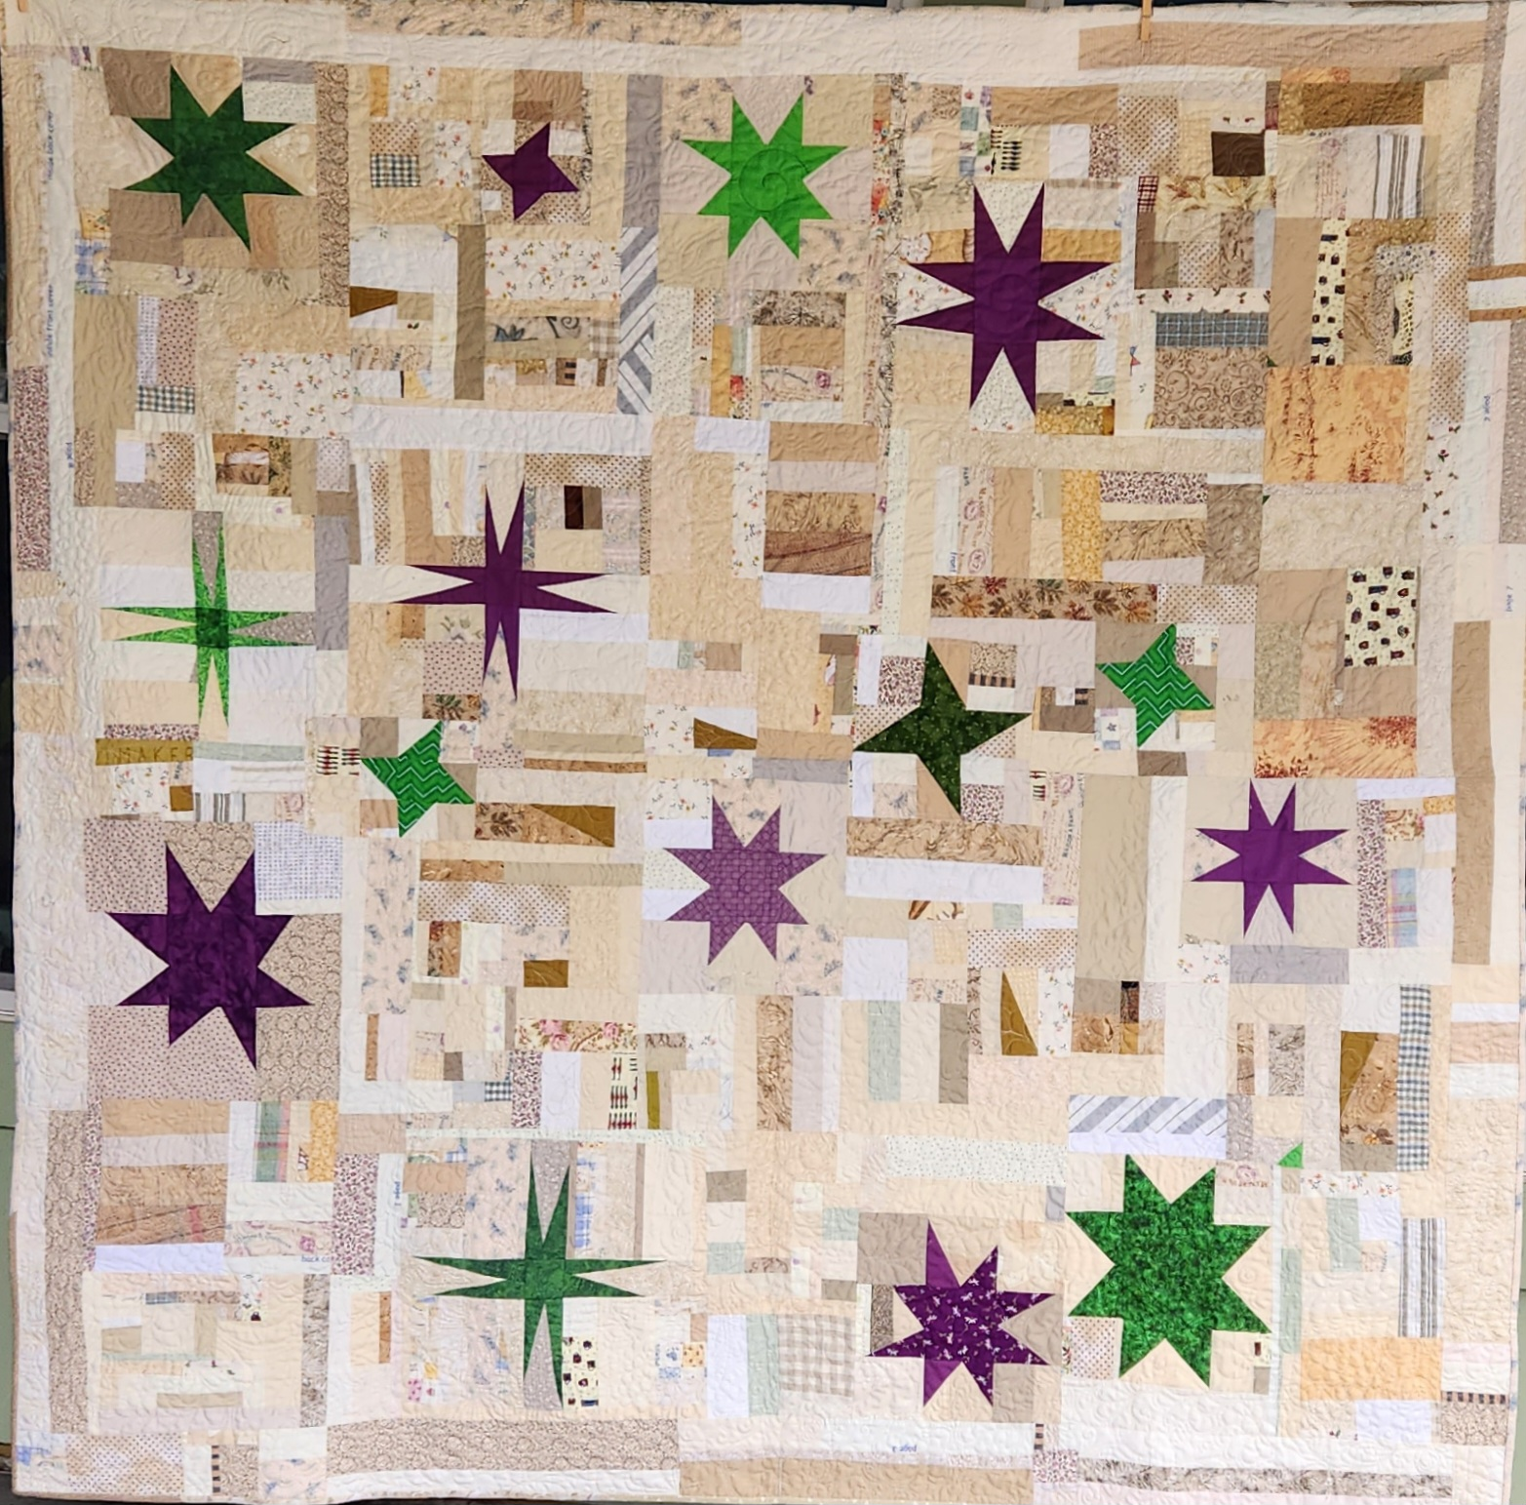
Daystar began as easy, mindless sewing on a difficult day. Eventually, I had large pieces of “fabric,” but they made for a bland flimsy. I needed some color somewhere and remembered a student’s use of green and purple and played with improv stars. Those stars added fresh color to my flimsy.
Daystar, 2023
(use of negative space)

Slide 32
Quilts:
Reflections in Gray; 70″ x 84″; 2012 (Quiltcon 2013)
Modern Crosses, lap quilt, July 2015
Math Is an Expletive; 59″ X 59″; 2015;
Modern Scrap Sampler; 37″ X 44″, 2016;
Tranquility, 55″ X 60″, 2016 (Inspired by Cindy Grisdela’s Adventures in Improv Quilts);
Solicitude, 45″ X 60″, 2017 (Inspired by Cindy Grisdela’s Adventures in Improv Quilts);
7. Murky Waters, 54″ X 56″; Jan 2017;
8. Give Me Words; 54″ X 58″; 2020;
9. The Retreat 48" X 60“, 2020;
10. Row Houses; 2020; 30″ X 27″
11. Daystar, 2023;
12. Summer Sangria, 88” X 92”,2024;
13. Seasoned in Louisiana, 76” X 92”, 2024;

Slide 33
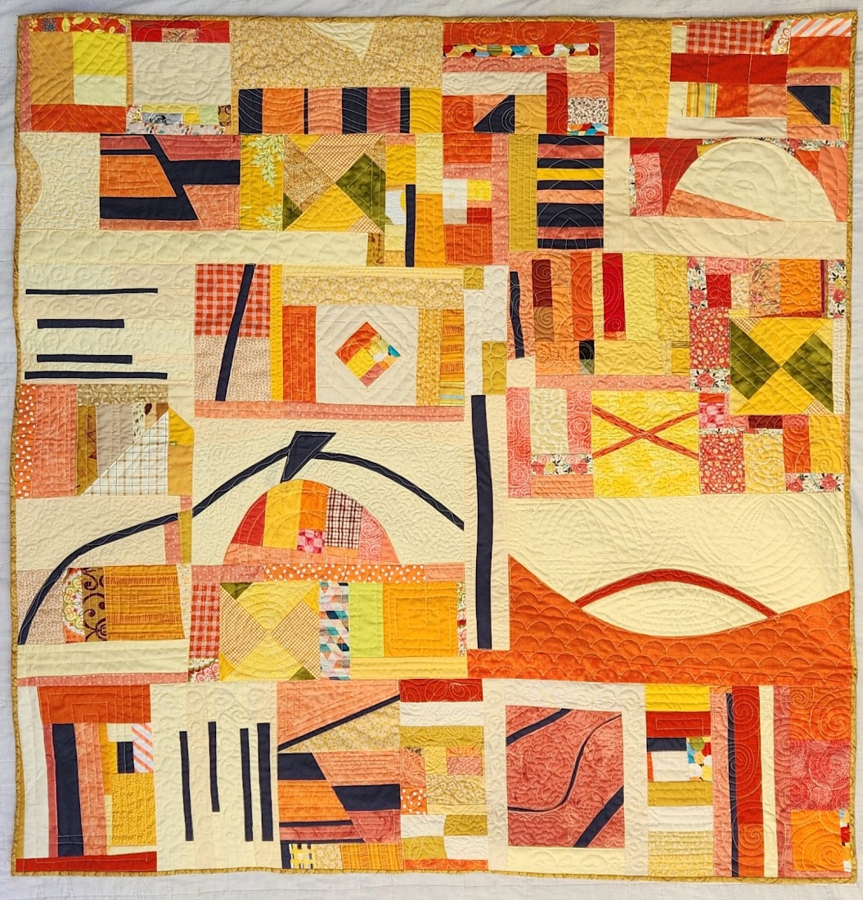
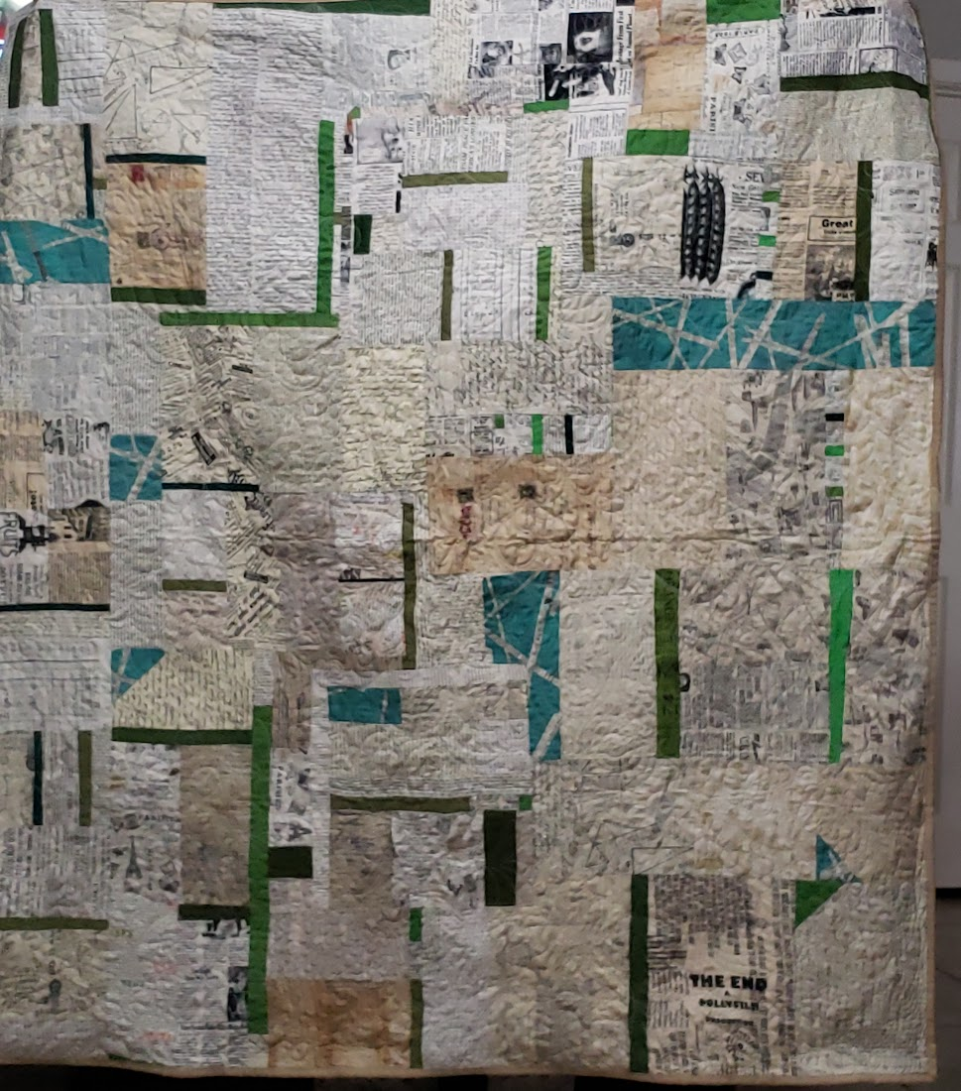
Citrus Sherbert, 50″ X 50″, 2023
(maximalism)
Give Me Words; 54″ X 58″; 2020
(use of negative space; minimalism)

Slide 34
Suggested Titles
Sunday Morning Quilts by Amanda Jean Nyberg
Improv Quilts: Building confidence in color and technique by Laura Lowen
Imperfect: Embracing Improv Quilting by Julie Burton
Adventures in Improv Quilts by Cindy Grisdela
FreeHand Curve Quilts by Cindy Grisdela
Improv Quilting by Irene Rodrick
Intuitive Color & Design: Adventures in Art Quilting by Jean Wells
Getting Started in Improv Quilting by Amy Ellis
The Improv Handbook for Modern Quilters by Sherri Lynn Wood

Slide 35
What have you learned about
Improv Techniques—creating fabric from scraps, using traditional blocks, turning scraps into complex blocks, creating your own blocks
Organizing Improv Blocks and Chunks
Color Theory
Minimalism vs Maximalism
Alternative Gridwork
Use of Negative Space

Slide 36
Thank you!
Play in Improv
Workbook
Mary Marcotte
https://marymarcotte.com
mary.marcotte@gmail.com

